Slide 1

Basic Electronic Components

Slide 2
Basic electronic Components:
Resistor and its types.
Capacitor.
Diodes.
Voltage regulators
Relays.
Transistors.
LED And LCD.

Slide 3
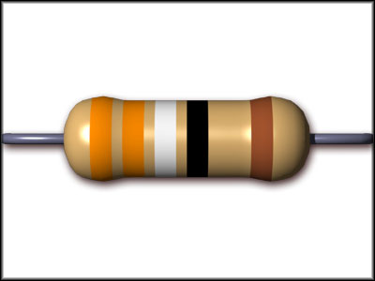
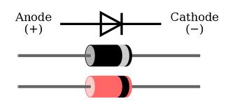
Resistor:
Which opposes the flow of electric current.
Diode:
The device which allows the current to flow only in one direction

Slide 4
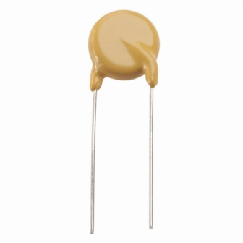
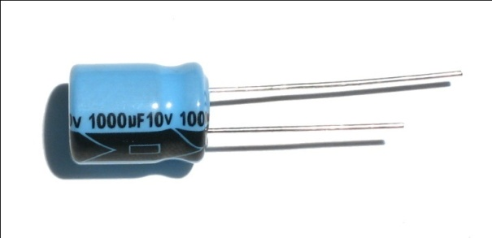
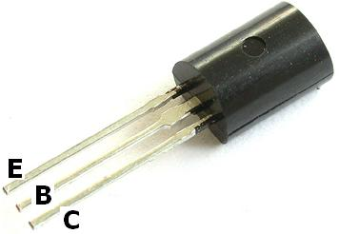
Capacitor:
Which stores the charge in the form of electric field.
Transistor:
A transistor is a semiconductor device used to amplify and switch electronic signals and electrical power

Slide 5
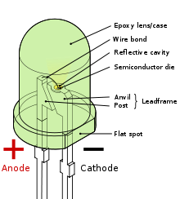
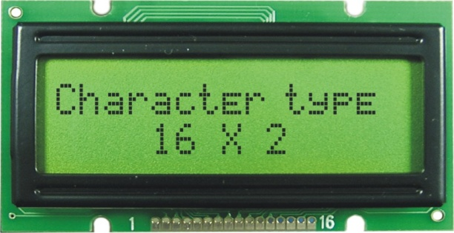
LED
A light-emitting diode (LED) is a semiconductor light source. LEDs are used as indicator lamps in many devices and are increasingly used for other lighting.
LCD
A liquid crystal display (LCD) is a flat panel display, electronic visual display , or video display that uses the light modulating properties of liquid crystals. Liquid crystals do not emit light directly.

Slide 6
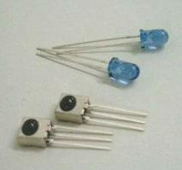
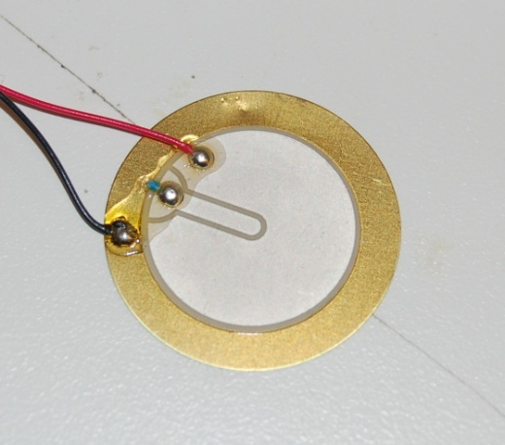
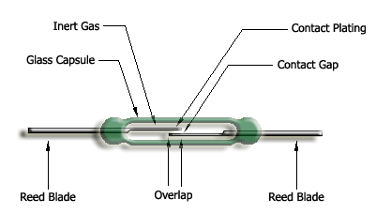
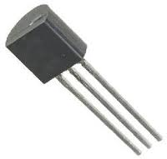
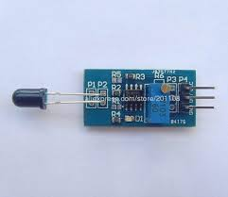
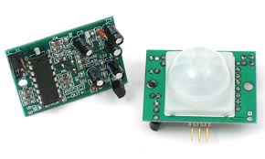
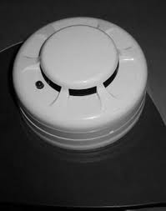
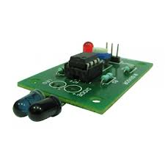
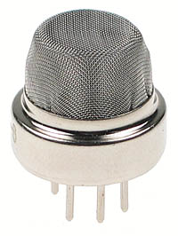
Sensors
IR Sensors
Piezo electric sensor
Magnetic sensor
Temp Sensor
Fire Sensor
PIR Sensor
Smoke Sensor
IR Sensor
GAS Sensor

Slide 7
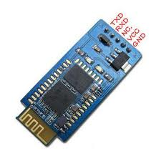
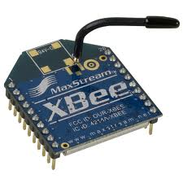
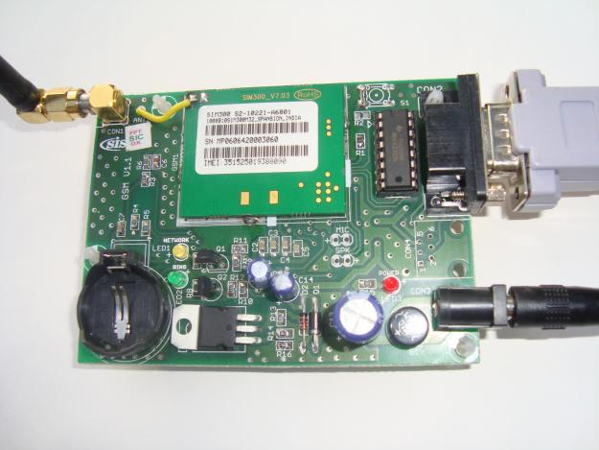
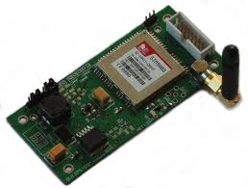
Wireless Modules
Bluetooth
Zigbee
GSM Modem
GPS Receiver

Slide 8

Any Queries?????

Slide 9
THANK YOU

